Slide 1
Keyword mining in scientific papers
Iordache Robert
Ingineria Sistemelor Internet

Slide 2
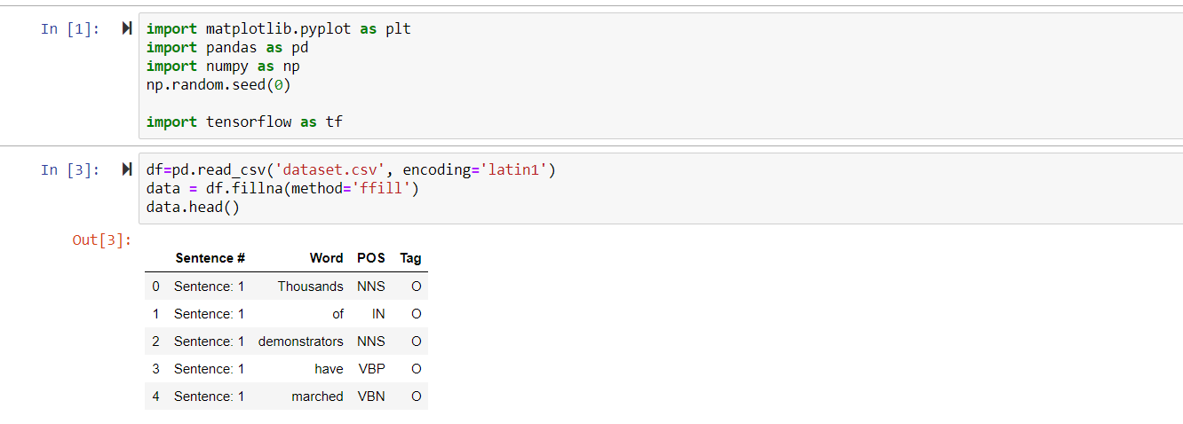

Slide 3
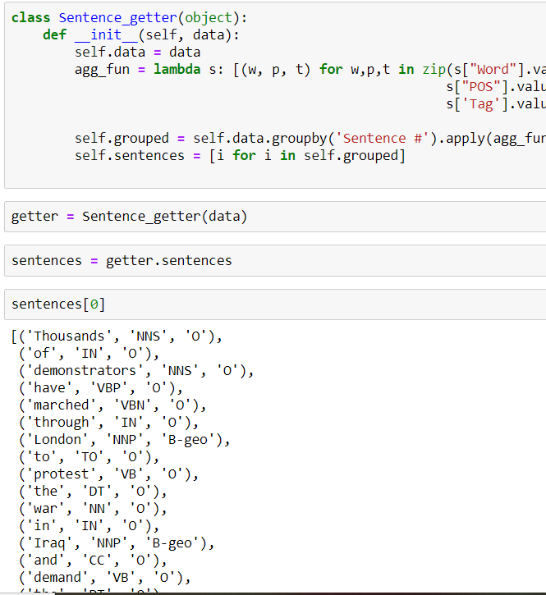

Slide 5
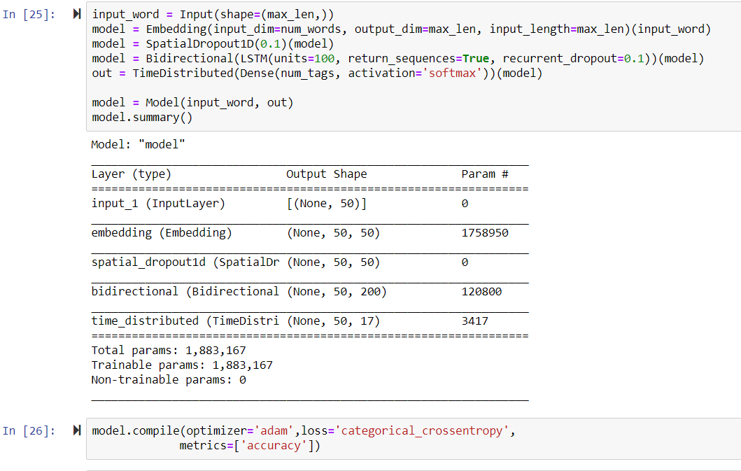

Slide 6
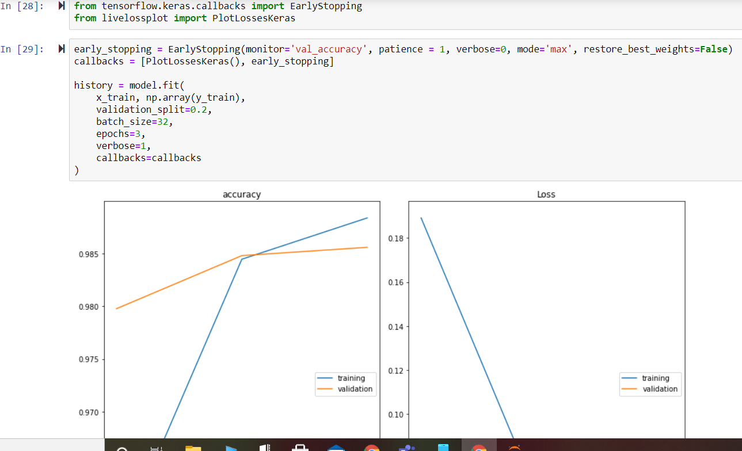

Slide 8
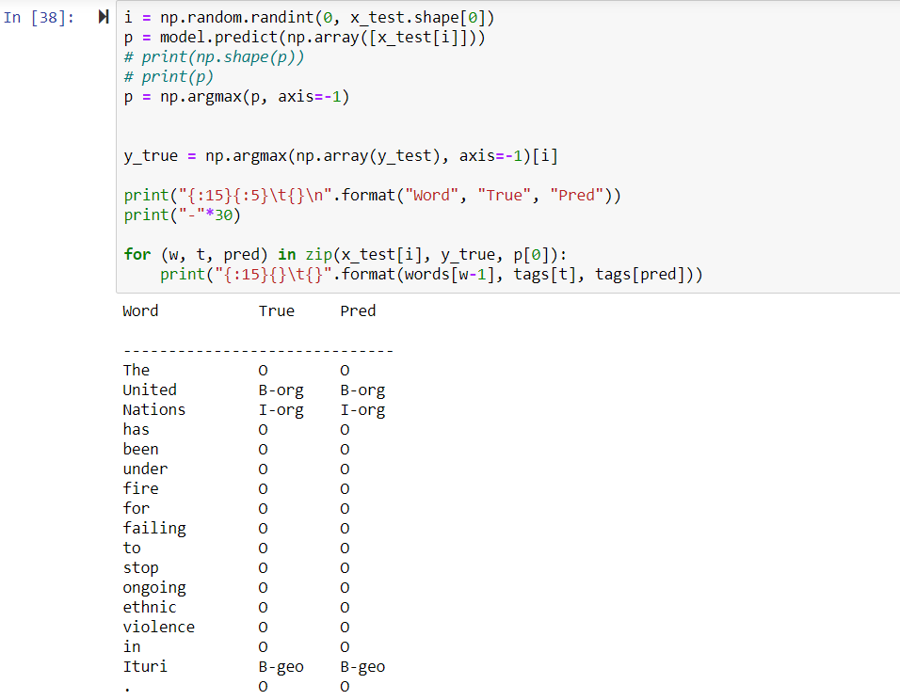

Slide 9
Multumesc!

